Slide 1
L E V E L 4
MONEY RISK
MANAGEMENT
Your edge is meaningless without capital to deploy it.
Risk management is the bridge between strategy and survival.
Capital Preservation
Position Sizing Rules
Stop-Loss Discipline

Slide 2
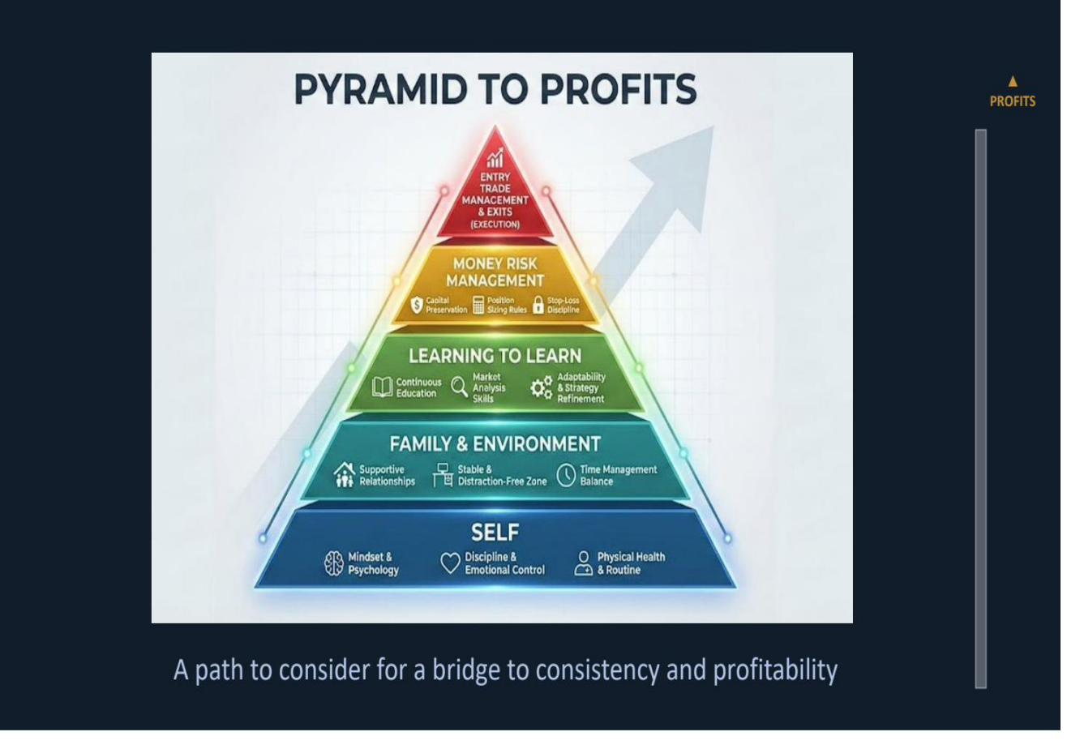
P A R T 2
▲
The Foundation We Built
PROFITS
Self | Family & Environment | Learning to Learn
Now we climb to the next level: Money Risk Management

Slide 3
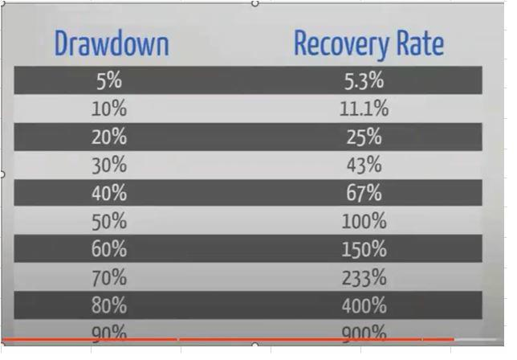
L E V E L 4
▲
MONEY RISK MANAGEMENT
PROFITS
Capital Preservation
Capital preservation is job number one — not because it is conservative, but because math is unforgiving. A 20% drawdown needs a 25% gain to recover. A 50% drawdown needs 100%. The deeper the hole, the more unrealistic the recovery. Protect your capital first; everything else — edge, strategy, growth — depends on it.
The 2% Rule — Never risk more than 1-2% of total account equity on a single trade — this ensures that no single loss can meaningfully damage your ability to continue trading.
Asymmetric Recovery — Recovery math is brutally non-linear — once drawdown exceeds 20%, the return needed to recover grows exponentially; capital preservation prevents entering this death spiral.
Survive to Compound — The first goal of every trading session is to still be trading tomorrow — compounding only works when there is capital left to compound; blown accounts compound nothing.

Slide 4
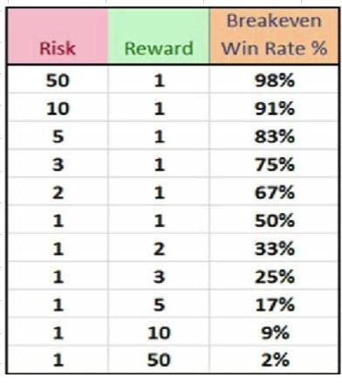
L E V E L 4
▲
MONEY RISK MANAGEMENT
PROFITS
Position Sizing Rules
Position sizing is how you translate edge into survival. A great setup with reckless size becomes a gamble; a mediocre setup with disciplined size stays manageable. The breakeven table reveals a critical truth: the worse your risk-to-reward ratio, the higher the win rate you need just to break even — and most traders overestimate their win rate.
Risk-to-Reward Drives Everything — A 1:1 risk-to-reward ratio requires a 50% win rate just to break even — no profit, no edge. Moving to 1:2 drops your breakeven to 33%, giving you room for error and psychological breathing space.
Size for the Worst Case — Position size should be calculated from your stop-loss distance, not from how much you want to make — start with the loss you can absorb and work backward to determine share count or contract quantity.
Never Average Down — Adding to a losing position is doubling your exposure to a trade the market is telling you is wrong — increasing size on losers violates every principle of capital preservation and position discipline.

Slide 5
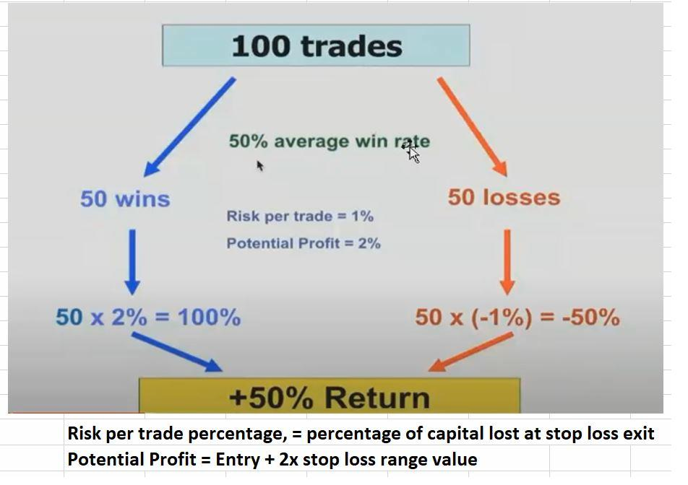
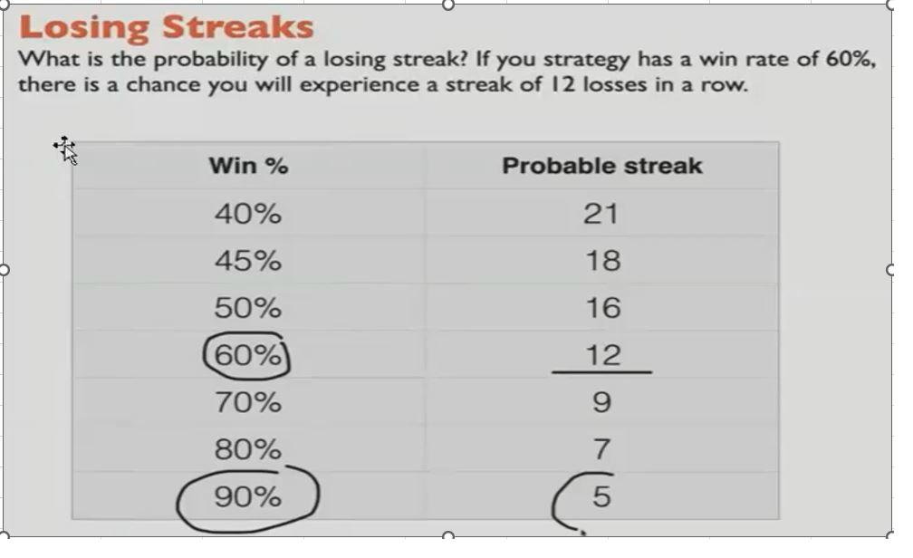
L E V E L 4
▲
MONEY RISK MANAGEMENT
PROFITS
Stop-Loss Discipline
A stop-loss is not a suggestion — it is the hard boundary between a controlled loss and a catastrophic one. Even a strategy with a 60% win rate will experience streaks of 12 consecutive losses. Without pre-defined stops, those inevitable losing runs destroy accounts. The math is simple: define your exit before you enter, honor it without exception, and let the edge play out over a statistically significant sample.
Left: A 1:2 risk-to-reward ratio with just a 50% win rate yields +50% return over 100 trades. | Right: Even a 60% win rate faces probable 12-loss streaks — your stop-loss is what keeps you alive through them.

Slide 6
L E V E L 4
▲
MONEY RISK MANAGEMENT
PROFITS
Fixed % vs. Fixed Dollar Risk
Two approaches to defining risk per trade — one scales with your account and protects against ruin; the other stays static and creates hidden danger as your account fluctuates.
FIXED % OF ACCOUNT BALANCE
FIXED DOLLAR AMOUNT
How it works — Risk a fixed percentage (e.g. 1-2%) of current account balance on each trade — as the account grows, dollar risk grows; as it shrinks, dollar risk shrinks automatically.
How it works — Risk a fixed dollar amount (e.g. $200) on every trade regardless of account balance — stays constant whether your account is up 30% or down 30%.
Built-in protection — During drawdowns your position size shrinks proportionally, making it mathematically harder to blow up — the account self-corrects like a circuit breaker.
Escalating danger — As the account declines, fixed dollar risk becomes an increasing percentage of remaining capital — $200 on $10K is 2%, but on $5K it becomes 4%, accelerating ruin.
Compounding advantage — As your account grows, so does your risk budget — winners naturally become larger over time, enabling exponential growth at the same percentage exposure.
No compounding benefit — When the account grows, risk stays flat — you miss the compounding advantage of scaling winners. It caps upside while exposing downside to percentage creep.
VERDICT: Fixed percentage scales with your equity curve — it protects in drawdowns and compounds growth. Fixed dollar is simpler but structurally dangerous.

Slide 7
L E V E L 4
▲
MONEY RISK MANAGEMENT
PROFITS
Delta at Entry: What You're Really Buying
Delta at entry determines how price movement, time decay, and volatility shifts affect your position. This is a snapshot at the moment of entry — all three forces shift continuously after that.
Leverage / Risk
Δ 35
At The Money
Δ 55
In The Money
Δ 75
$ for $ Price Movement
(Directional Sensitivity)
▲
▲
▲
Lower $ gain
Moderate $ gain
Highest $ gain
Time Decay
(Theta Exposure)
▼
▼
▼
Fastest decay
Moderate decay
Slowest decay
Volatility Impact
(Vega Sensitivity)
▲
▲
▲
Most sensitive
Moderate
Least sensitive
This grid reflects conditions at the moment of entry only. Delta, theta, and vega shift continuously as price, time, and volatility change after entry.
▲ = Favorable to P&L ▼ = Unfavorable to P&L ▲ = Exposure (direction depends on vol move)

Slide 8
L E V E L 4
▲
MONEY RISK MANAGEMENT
PROFITS
Choosing Your Delta: Trade-Offs by Entry
Each delta tier represents a fundamentally different risk profile. There is no universally correct choice — the right delta depends on your conviction level, time horizon, and how much capital you are willing to put at risk on a single setup.
Leverage / Risk
Δ 35
At The Money
Δ 55
In The Money
Δ 75
PROS
PROS
PROS
Lowest capital outlay per contract. Maximum leverage — small price moves create large % returns. Best for high-conviction directional bets with tight timeframes.
Balanced exposure — moderate leverage with manageable time decay. Roughly 50/50 probability of finishing in the money. Most liquid strike — tightest bid-ask spreads, best fills.
Highest delta — moves closest to stock price, most dollar-for-dollar. Lowest time decay impact — intrinsic value protects against theta. Most forgiving of timing errors.
CONS
CONS
CONS
Fastest time decay — theta is your biggest enemy. Requires significant price movement to profit. Highest probability of expiring worthless.
Moderate theta — time still works against you. Higher premium than OTM — more capital at risk per contract. Can be indecisive in ranging markets.
Highest premium — largest capital commitment per contract. Lower leverage — % returns on investment are smaller. Less benefit from volatility expansion.
High reward, high risk. Use only with strong conviction and tight stop discipline.
The balanced choice. Good for most setups with a directional lean but not extreme conviction.
Conservative options play. Acts most like owning shares but with defined risk and less capital.

Slide 9
L E V E L 4
▲
MONEY RISK MANAGEMENT
PROFITS
Portfolio Risk: Total Exposure at a Glance
Individual trade risk is only half the equation. If you run the same setup across multiple positions, your total account exposure is the sum of every open risk — and correlated positions amplify that exposure far beyond what the math suggests. Five trades at 2% risk each is not 2% risk — it is 10% of your account on the line simultaneously.
THE CORRELATION TRAP
THE MATH OF STACKED RISK
When every position uses the same setup on correlated assets (e.g. 5 tech stocks, or 5 SPY-correlated names), a single market move hits all positions at once. Your diversification is an illusion — you effectively have one giant position split across multiple tickets.
5 positions × 2% risk each = 10% total exposure
If correlated and all stop out together, that is a 10% drawdown in a single session — requiring an 11.1% gain just to recover.
Max Open Positions
Total Capital at Risk
Correlation Awareness
Set a hard cap on simultaneous open trades — typically 3 to 6 for active day traders, fewer for swing positions. Every additional open position adds to total account exposure and increases the cognitive load of managing exits under pressure. Fewer positions means sharper focus and better execution on each one.
Track the sum of all open position risk as a single number — if you risk 2% per trade and have 5 positions open, your total capital at risk is 10%. Set a portfolio-level hard stop: many professional traders cap total open risk at 6-10% of account value. When you hit the ceiling, no new entries until existing risk comes off.
Before adding a new position, assess whether it moves with your existing exposure. Five trades on five different tech stocks is functionally one bet on the tech sector. Diversification only counts when the underlying drivers are different — sector, asset class, or market regime sensitivity.

Slide 10
L E V E L 4
▲
MONEY RISK MANAGEMENT
PROFITS
Single-Setup Portfolio Mitigation
Running one core setup across multiple positions is common and can be highly effective — but it demands deliberate risk mitigation at the portfolio level. These strategies reduce correlated blowout risk while letting your edge compound.
Uncorrelated Assets
Scale Out of Winners
Trailing Stop Losses
Spread positions across asset types that don't move together — equities, commodities, forex, or different sectors. If your setup works on SPY, GOLD, and EURUSD simultaneously, a single market shock won't hit all three the same way.
Take partial profits at defined levels (e.g. 50% off at 1R, let the rest run). This locks in gains, reduces open exposure, and converts risk into house money — your remaining position is now a free trade funded by realized profit.
Move stops to breakeven after a trade moves in your favor, then trail behind structure. This converts open risk to zero-risk exposure — your total portfolio risk drops automatically as winners develop without you closing the position.
Staggered Entries
Sector & Regime Limits
Daily Portfolio Heat Check
Avoid opening all positions at once. Staggering entries across different times or triggers means you won't be max-exposed to a single market move. If your first entries fail, you preserve capital for better setups later in the session.
Cap the number of positions in any single sector or correlated group — e.g. max 2 tech names at once. Also track the current market regime: in high-correlation environments (VIX spikes, macro events), reduce total position count regardless of individual setup quality.
Before each new entry, calculate your total open risk across all positions. Ask: if every stop hits right now, what is my total drawdown? If the answer exceeds your portfolio risk cap, the answer is no new trades — regardless of how good the setup looks.
KEY: Your edge is on individual trades. Your survival is on portfolio management. Both must be disciplined.

Slide 11
MONEY RISK MANAGEMENT
The Numbers Don't Negotiate
Risk management is not a chapter in your trading plan — it IS the plan. Without it, edge is theoretical and ruin is inevitable. Money Management is the operating system that entries run on — without it, even the best setup self-destructs.
CAPITAL PRESERVATION
The asymmetric math of drawdowns makes prevention infinitely more efficient than recovery. A 50% loss requires a 100% gain — protect capital as priority one.
POSITION SIZING
Use fixed percentage of account balance to define risk per trade. Size from the stop-loss backward. The breakeven table proves that risk-to-reward ratio, not just win rate, determines profitability.
STOP-LOSS DISCIPLINE
Pre-define every exit before entry. Honor stops without exception. Even winning strategies produce long losing streaks — only disciplined exits prevent those streaks from becoming account-ending events.
Coming Next: Execution — Entries, Trade Management & Exits

